Slide 1



Power Platform Governance Monitoring & Analytics

Slide 2
Disclaimer

Slide 3
Monitor and Manage the Power Platform
1
Set up and view activity logs in Office 365 Audit Logs
2
Gain Insights into capacity and storage consumption in adoption in Power Platform Admin Center
3
View out-of-the-box tenant and environment level Analytics for usage and adoption in Power Platform Admin Center and Power Apps / Automate portals
4
Monitor platform services and planned & unplanned platform changes/incidents
Notes:
Secure your tenant
Establish an environment strategy
Setup DLP policies
Monitor your tenant
Activity logs
Alert & action based on activity
Deploying apps
Application lifecycle management
Azure DevOps task

Slide 4
Activity logs in Office 365 Audit Logs
1
Notes:
Dataverse is focused on database and model-driven app user activity
PowerApps is targeted toward canvas app
The data is stored only in the region that an environment is hosted in.

Slide 5
Access Audit Logs
TALK TRACK
User has to be assigned the View-Only Audit logs or Audit-logs role in Exchange online to search the O365 audit log. By default these roles are assigned to the Compliance Management and Organization Management role groups on the permissions page in the Exchange admin center. Global admins in O365 and Microsoft 365 are automatically added as members of the Organization Management role group in Exchange Online.
PowerApps, Power Automate, Dataverse audit records are available at https://compliance.microsoft.com/auditlogsearch
ACTIVITY LOGGING
Available with Office E3 or greater license and integrated with Office Security and Compliance center.
Must be enabled at the organization/tenant level.
Office provides API’s to query this data, which is currently used by many SIEM vendors to use the Activity Logging data for reporting.
Notes:
Dataverse is focused on database and model-driven app user activity
PowerApps is targeted toward canvas app
The data is stored only in the region that an environment is hosted in.

Slide 6
Monitor Activity Parameters for Power Apps & Automate
Power Automate
Power Apps
Created flow
Edited flow
Deleted flow
Edited permissions
Deleted permissions
Started a paid trial
Renewed a paid trial
Created app
Edited/save app (draft)
Published app
Deleted app
Restored an app from app version
Launched app
Marking app as featured
Marking app as hero
Edited app permissions
Deleted app permissions
Notes:
Dataverse is focused on database and model-driven app user activity
PowerApps is targeted toward canvas app
The data is stored only in the region that an environment is hosted in.

Slide 7
Monitor Critical Activity Parameters of the Dataverse
Admin Activity Logged
User Activity Logged
Publishing customizations
Configuring instances by adding solutions to instance
Team and user management - who was added, deleted, access rights of user/team
Deletes of attributes
Backup and Restore actions
Managing instances - New instance added and delete instance
Creates, Reads, Updates, Deletes on records and Dataverse metadata
Dataverse record views
Export to excel
SDK calls
Backend Microsoft support engineer CRUD activities
Reports viewed
Notes:
Dataverse is focused on database and model-driven app user activity
PowerApps is targeted toward canvas app
The data is stored only in the region that an environment is hosted in.

Slide 8
Monitoring Storage Capacity and Add-on’s
2
Notes:
Dataverse is focused on database and model-driven app user activity
PowerApps is targeted toward canvas app
The data is stored only in the region that an environment is hosted in.

Slide 9
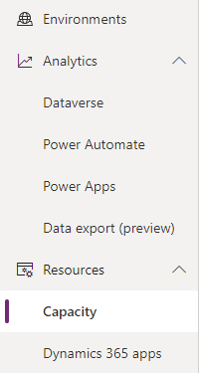
Gain Deeper Insight on Storage Capacity
Capacity management & enforcement
Understand storage and consumption
Access for environment admins, power platform service admins, D365 and global admins and individual users who have purchased a license
https://aka.ms/ppac
Notes:
The Power Platform offers admins greater insight into how storage capacity is being used.

Slide 10
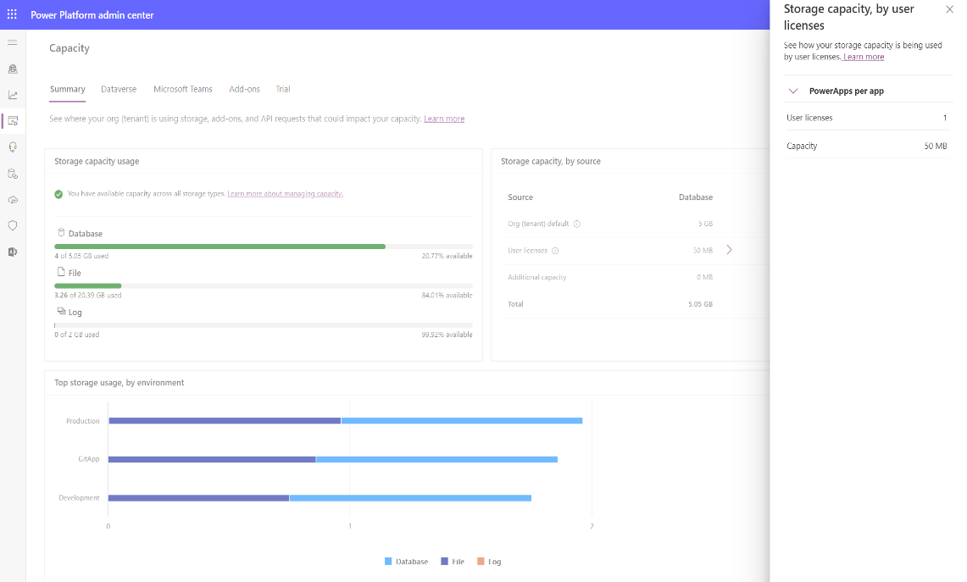
Default Environment
Capacity Page Details
Dataverse
In Power Platform Admin Center, select Resources > Capacity > Summary
All tables of Dataverse, including system tables, are included in the storage capacity reports.
Storage capacity usage
Database – All tables
File – Tables having file or image data type as well as Attachment, AnnotationBase, Insights application OOB tables
Log – AuditBase & PlugInTraceLogBase tables (Audit logging)
Storage capacity, by source (Database, File, Log)
Org (tenant) default
User licenses - Additional capacity added for every user license purchased
Additional storage - Any additional storage you bought like add-on
Total storage available
Top storage usage, by environment
Assigned storage capacity per license
4
2
1
3

Slide 11
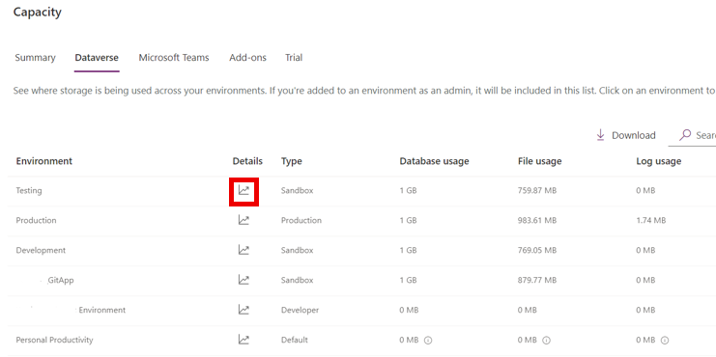
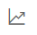
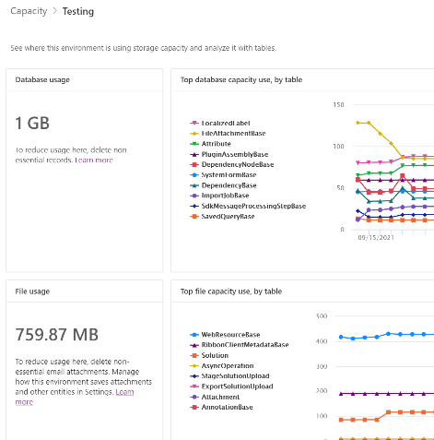
Default Environment
Environment level breakdown
Dataverse
In Power Platform Admin Center, select Resources > Capacity > Dataverse
Provides similar information as the Summary tab, but with an environment-level view
See environment capacity analytics details by clicking ( )
Note that following environments don't count against capacity and are shown as 0 GB:
Trial
Preview
Support
Developer
You can select an environment that's showing 0 GB, and then go to its Environment Analytics page to see the actual consumption

Slide 12
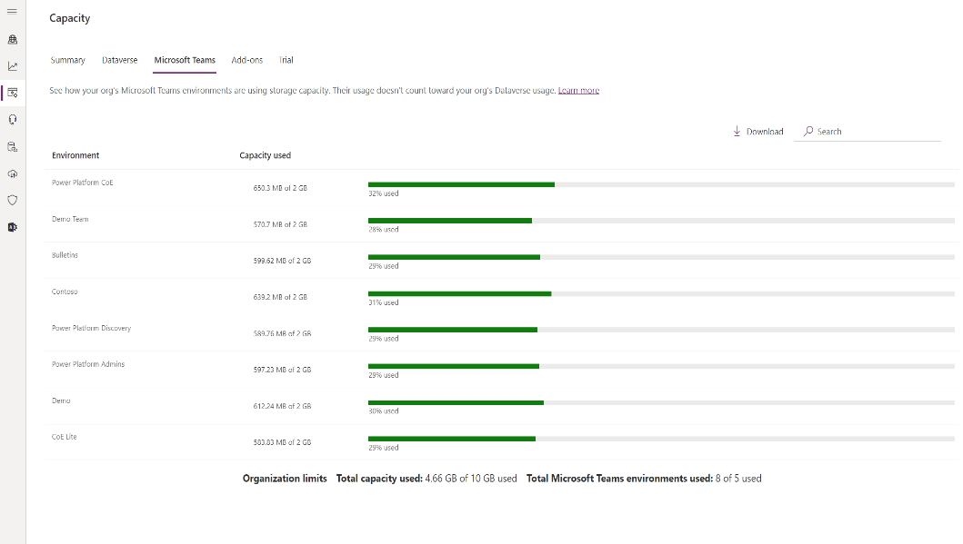
Default Environment
Microsoft Teams Environments
Dataverse
In Power Platform Admin Center, select Resources > Capacity > Microsoft Teams
Provides information about database capacity of Microsoft Teams environments
as the Summary tab, but with an environment-level view

Slide 13

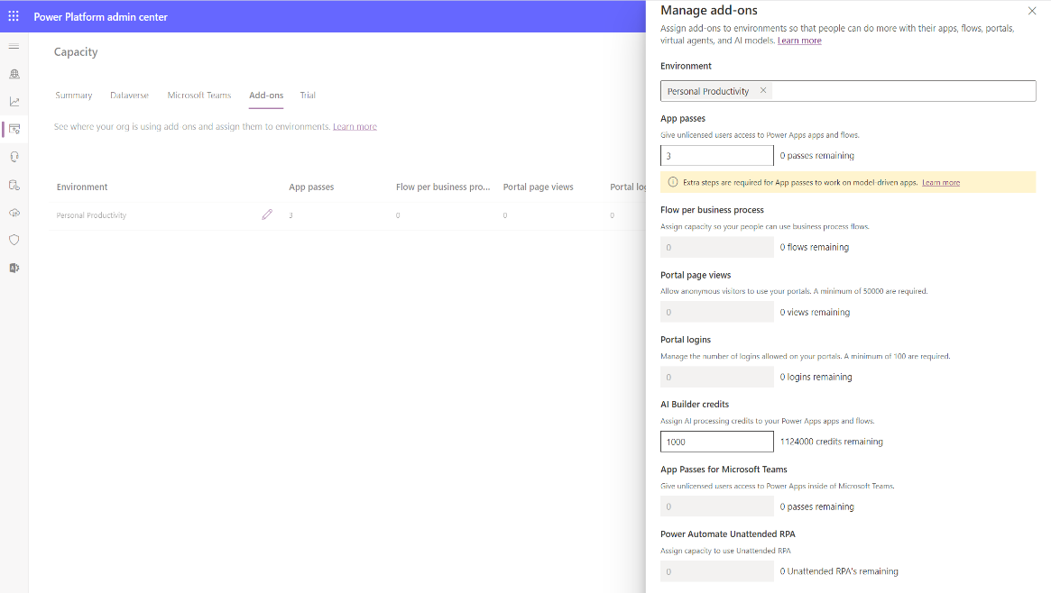
Capacity add-on assignments per environment
Capacity add-on assignments per environment
Notes:
Finally, there is a detailed view on file capacity and logs. All of this information is rich in detail and easily accessible.

Slide 14
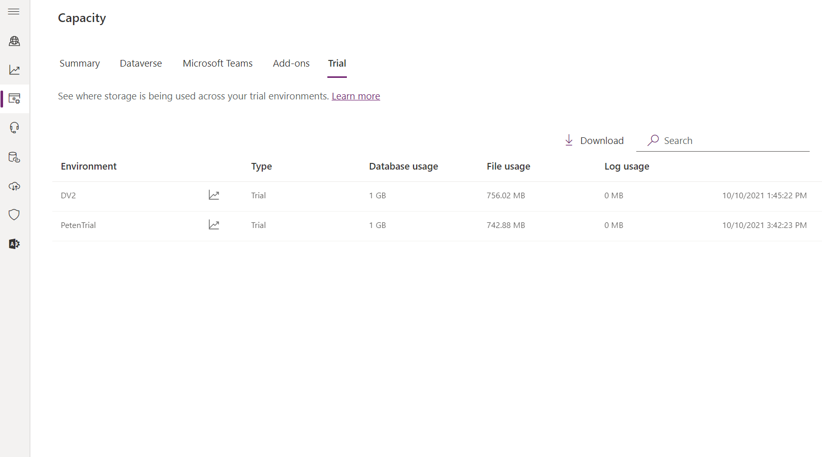
Trial environment
Trial environments does not consume tenant level capacity unless converted to production environment
Notes:
Finally, there is a detailed view on file capacity and logs. All of this information is rich in detail and easily accessible.

Slide 15
Capacity enforcements
Following storage capacity enforcements apply today
Tenant overall capacity need to be with-in the entitled limits. The PPAC experience will call out if that is not the case
Creating a new environment, copy and restore are the three operations that are enforced today in an event of capacity overuse
Min 1GB of available DB capacity is required for creating a new environment
Notes:
Also, to ensure compliance, we apply some capacity enforcements.

Slide 16
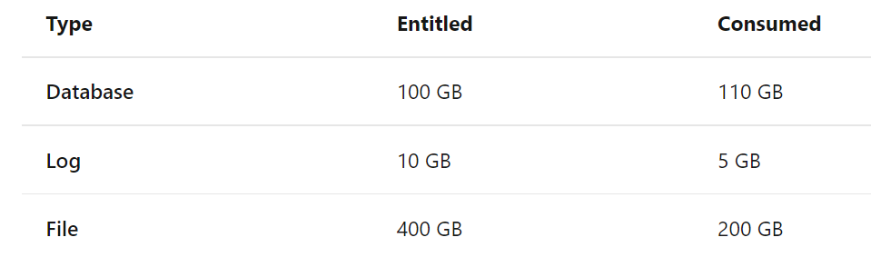
Capacity enforcement Example 1 - Overage
Database storage is over capacity, overage enforcement
This tenant is 10 GB over in database usage. Despite having 200 GB excess file storage, the tenant is considered to be in deficit.
This tenant should free up storage or purchase more capacity.
Notes:
Also, to ensure compliance, we apply some capacity enforcements.

Slide 17
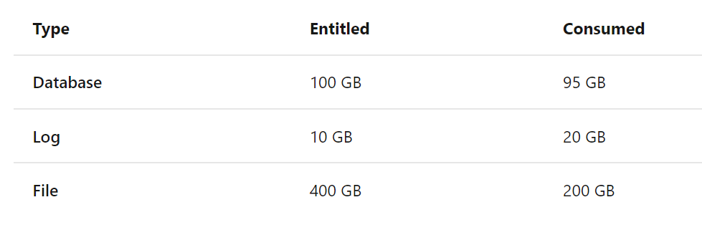
Capacity enforcement Example 2 - Overage
Log storage is over capacity, overage enforcement
This tenant is 10 GB over in log usage and has only 5 GB available in database capacity, the tenant is considered to be in deficit.
This tenant should free up storage or purchase more capacity.
Notes:
Also, to ensure compliance, we apply some capacity enforcements.

Slide 18
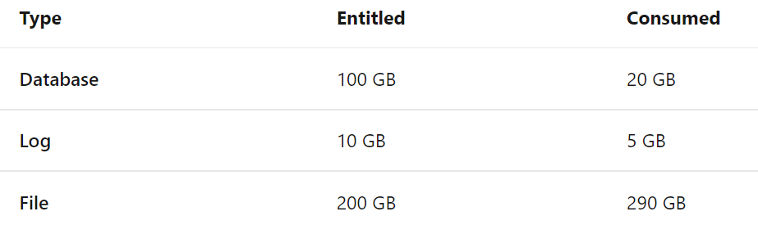
Capacity enforcement Example 3 - Overage
File storage is over capacity, overage enforcement
This tenant is 90 GB over in file usage. Despite having 85 GB available (80 GB database + 5 GB log) in storage capacity, the tenant is considered to be in deficit.
This tenant should free up storage or purchase more capacity.
Notes:
Also, to ensure compliance, we apply some capacity enforcements.

Slide 19
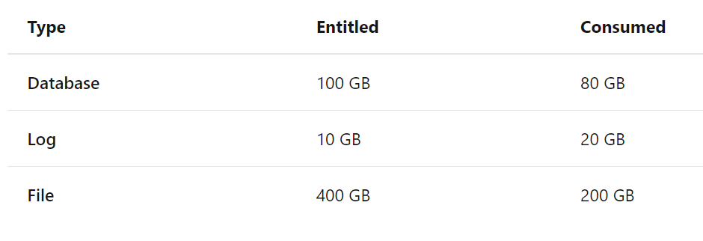
Capacity enforcement Example 4 - No Overage
Log storage is over capacity
This tenant is 10 GB over in log usage but has 20 GB available in database capacity. Therefore, the tenant isn't in deficit.
Note that file storage excess entitlement can't be used to compensate deficits in log or database storage.
Notes:
Also, to ensure compliance, we apply some capacity enforcements.

Slide 20
View Out of the box Analytics for usage and adoption
3
Notes:
Dataverse is focused on database and model-driven app user activity
PowerApps is targeted toward canvas app
The data is stored only in the region that an environment is hosted in.

Slide 21
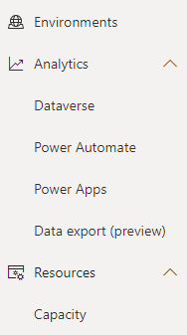
Gain Deeper Insight on Adoption, & Usage
https://aka.ms/ppac
Admin analytics
Tenant level analytics (preview)
Environment level analytics
Available from Power Platform admin center
Access for environment admins, power platform service admins, D365 and global admins
Data is stored for 28 days
Data is refreshed daily
Notes:
Dataverse is focused on database and model-driven app user activity
PowerApps is targeted toward canvas app
The data is stored only in the region that an environment is hosted in.

Slide 22
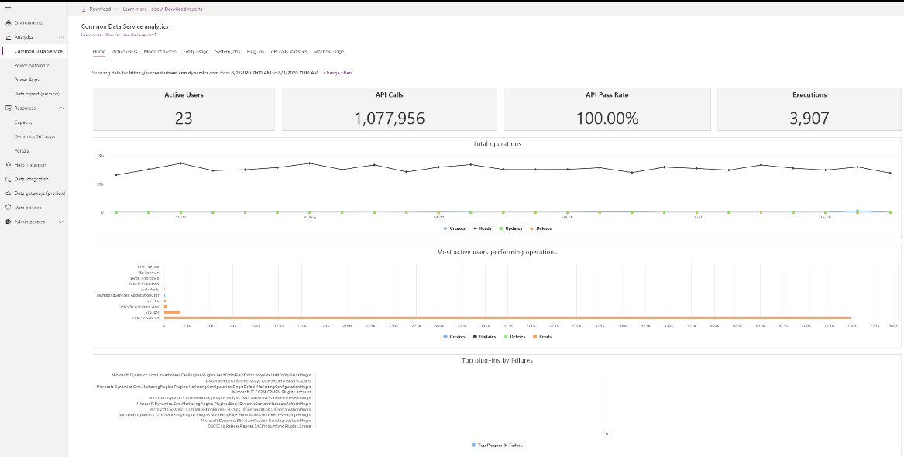
Monitoring Microsoft Dataverse
Click on Change Filters to select from a list of environments you have access to, as well as adjust the date range. The data will only be presented in the prior 28-day period.
Notes:
Microsoft Dataverse is focused on database and model-driven app user activity
PowerApps is targeted toward canvas app
The data is stored only in the region that an environment is hosted in.

Slide 23
Detailed Insight on Microsoft Dataverse
View insights at the environment level
Number of active users, trends, top active users
Mode of access by OS, device type, browser, business unit, security role
Dataverse out of the box and custom entity usage based of Creates, Reads, Updates, Deletes
System Jobs, Plug-in’s and API call statistics
As an administrator:
Confirm access modes by OS, device types or browser is compliant with standards of your organization
Understand specific CRUD (Create, Read, Update, Delete) activities performed with your apps
Get an overview of overall health by regular checks on platform API calls, system jobs operating, plug-in’s used by app makers
Notes:
Dataverse is focused on database and model-driven app user activity
PowerApps is targeted toward canvas app
The data is stored only in the region that an environment is hosted in.

Slide 24
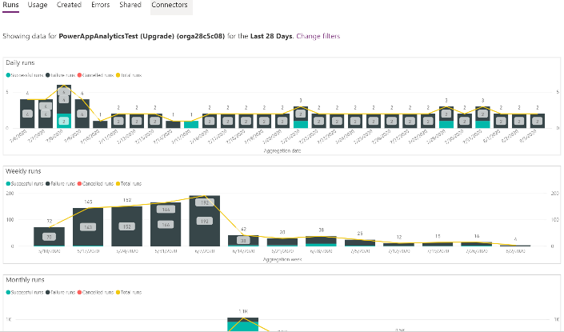
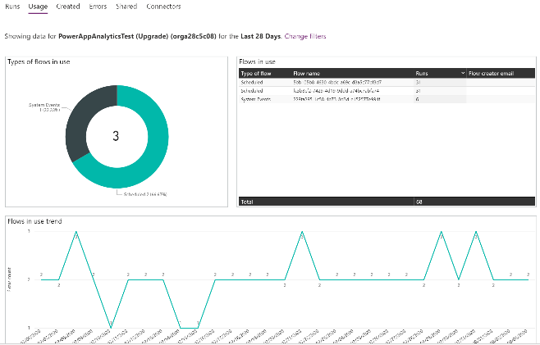
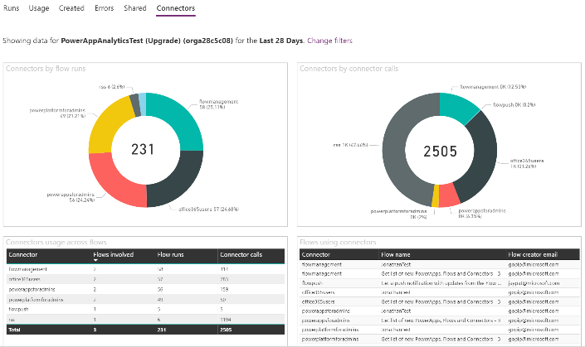
Power Automate Environment level views
Analytics is available for a 7, 14, 28-day time periods and allows users to switch between environments.
Notes:
Microsoft Dataverse is focused on database and model-driven app user activity
PowerApps is targeted toward canvas app
The data is stored only in the region that an environment is hosted in.

Slide 25
Power Automate admin analytics provides environment level views
Administrators can view data at the environment level
Type of flows created
Flow creation trends
Created flow list of view
Run metrics – Active runs, success and failure
Flow in use and trend
Shared flows and types, flow names, number of shares
Connectors by runs, number of connections, flows involved and drill down on flows
Total number of errors based off error types
Errors across flows with list of errors by flow name
As an administrator:
Monitor usage and look for insights related to types of flows that ae in use
Identify common errors by looking for errors by error type
Get insights into connector usage per flow along with flow creator email. Adjust data loss prevention policies to ensure no unnecessary flows are created in the environments and ensure overall security of platform
Note – Desktop Flow analytics is available in the COE toolkit
Notes:
Microsoft Dataverse is focused on database and model-driven app user activity
PowerApps is targeted toward canvas app
The data is stored only in the region that an environment is hosted in.

Slide 26
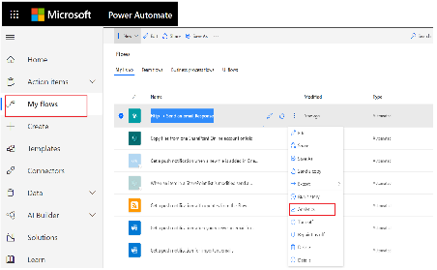
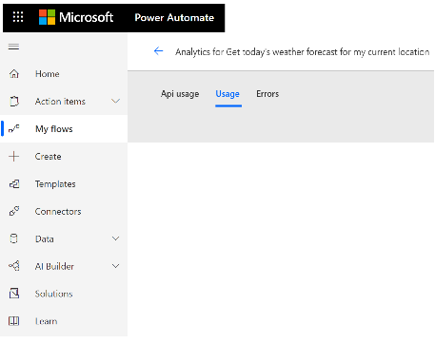

Maker analytics for Power Automate – Individual flow level views
Flow Makers and Administrators can view details for each flow within their scope, for last 7, 14, 28 days with data refreshed every 4-6 hours
https://flow.microsoft.com
Flow Usage
Flow Health
API usage
Runs by day
Total number of runs for the flow
Gain insights into when the flow is run with the flow run trends
The number of errors per day
Flow errors by type
Understand the details of a specific error – Error source, action or trigger name, error status code, error count, last error occurrence, last error message and detail
Notes:
Dataverse is focused on database and model-driven app user activity
PowerApps is targeted toward canvas app
The data is stored only in the region that an environment is hosted in.

Slide 27
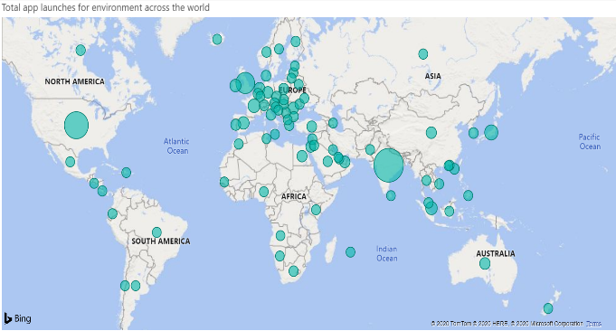
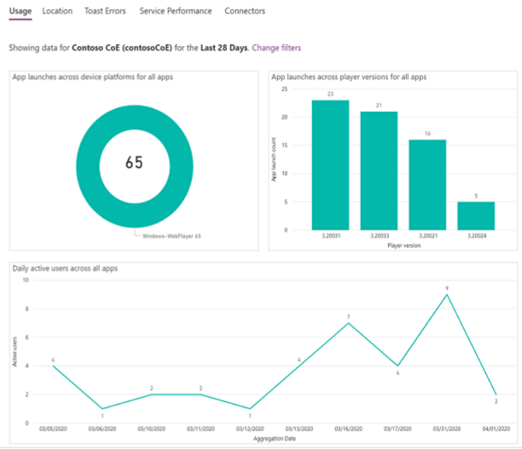
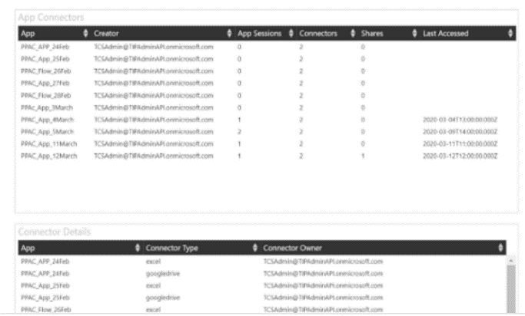
Power Apps Environment level views
Analytics is available for canvas apps for a 7, 14 and 28-day time periods and allows users to switch between environments.
Notes:
Microsoft Dataverse is focused on database and model-driven app user activity
PowerApps is targeted toward canvas app
The data is stored only in the region that an environment is hosted in.

Slide 28
Power Apps admin analytics provides environment level views
Administrators can view data at the environment level for canvas apps
Active Users – How many users are using the app and daily active usage
Location – Where is the app usage and filter by country
App Usage – App launches with filters for device platform, player version, country
Toast errors are errors which end users see
Errors per app in the environment,
Error trends across apps,
Overview across all apps for error breakdown by https status
Service Performance – Best and lest performing service(std and custom) in the environment
As an administrator:
Monitor how much and where apps are being used
Check out the platform being used to launch the apps, browser or mobile, Tailor your app updates based on platform and ensure that users are on the latest player version to ensure latest platform updates
Identify apps with most errors and common http errors and work with makers to understand and fix issues ensure overall security of platform
Get an overview of overall performance of different custom and standard API”s being used in the apps. Work with teams to fix issues proactively
Notes:
Microsoft Dataverse is focused on database and model-driven app user activity
PowerApps is targeted toward canvas app
The data is stored only in the region that an environment is hosted in.

Slide 29
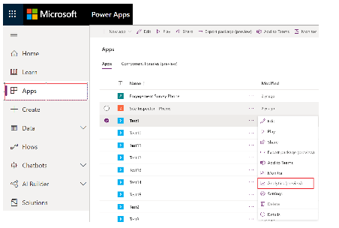
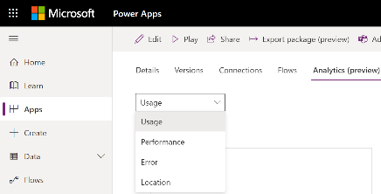
Maker analytics for Power Apps – Individual app level views
App Makers and Administrators can view details for each app within their scope, for last 7, 14, 28 days with data refreshed every 4-6 hours
https://make.powerapps.com
App Adoption and Usage
App Health
Active Users – How many users are using the app and daily active usage
Location – Where is the app usage and filter by country
App Usage – App launches with filters for device platform, player version, country
Toast errors are errors which end users see
Errors per app in the environment,
Error trends across apps,
Overview across all apps for error breakdown by https status
Performance – Best and lest performing service(std and custom) in the environment
Notes:
Dataverse is focused on database and model-driven app user activity
PowerApps is targeted toward canvas app
The data is stored only in the region that an environment is hosted in.

Slide 30
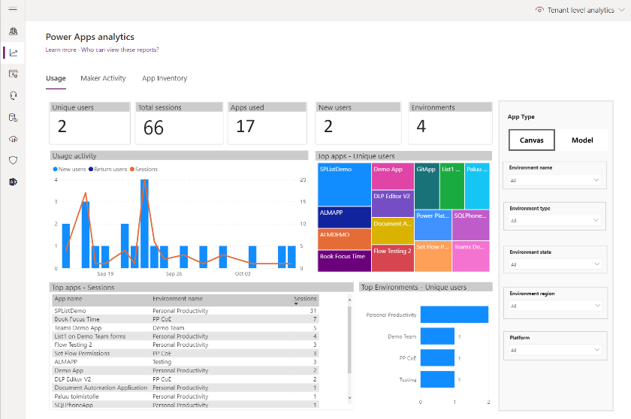
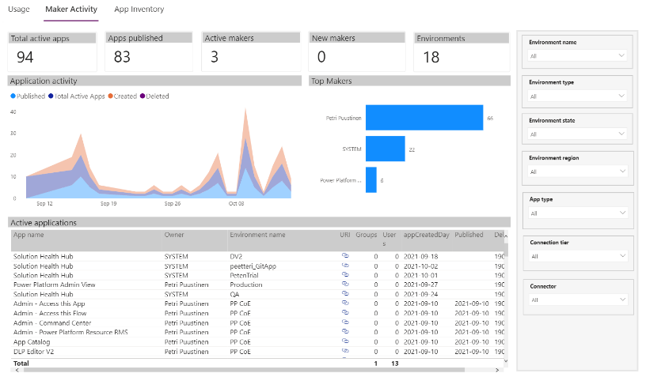
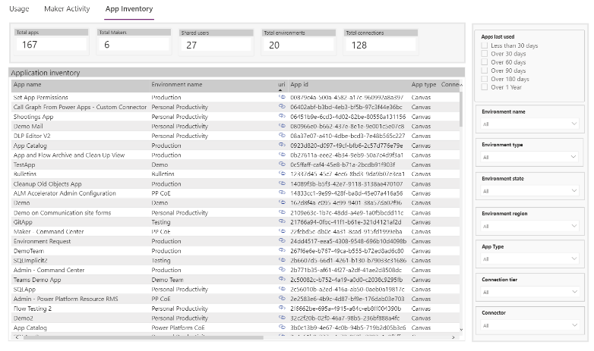
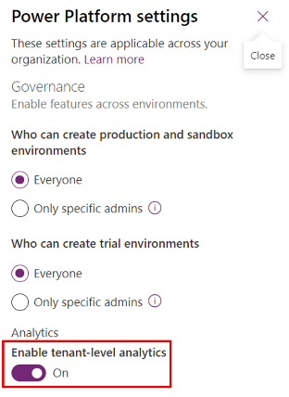
Power Apps Tenant level views
Analytics is available for canvas and model-driven apps
Need to be explicitly enabled in Power Platform settings
Notes:
Microsoft Dataverse is focused on database and model-driven app user activity
PowerApps is targeted toward canvas app
The data is stored only in the region that an environment is hosted in.

Slide 31
Power Apps tenant level analytics
Administrators can view data at the tenant level for canvas and model-driven apps
Unique users, Total sessions, Apps used, New users, Environments
Usage activity
Top Apps – Sessions / Unique users
Top Environments – Unique users
Maker activity
App inventory
As an administrator:
Monitor top apps and environments per activity
Monitor maker activity
See total number of Apps, Makers, Environments, Connections
See information when App is created, modified, last launched and for how many users/groups app is shared
Reports can be filtered by environment, environment type/state/region, app type, connection tier, connector, app last used
Notes:
Microsoft Dataverse is focused on database and model-driven app user activity
PowerApps is targeted toward canvas app
The data is stored only in the region that an environment is hosted in.

Slide 32
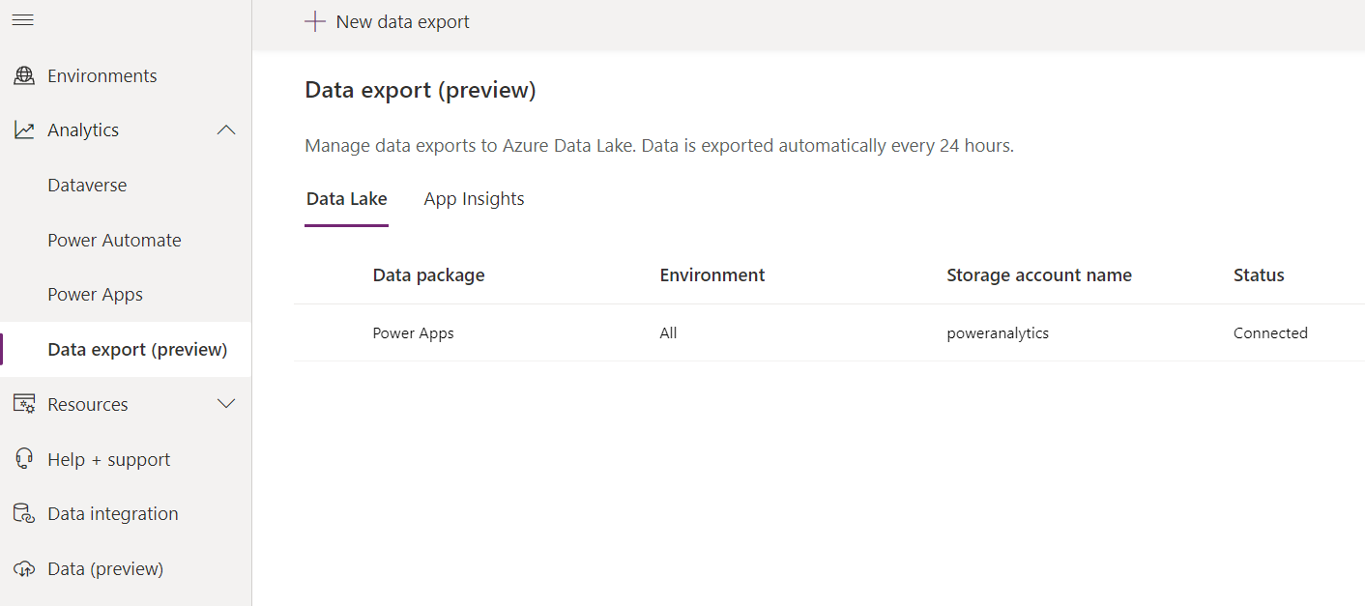
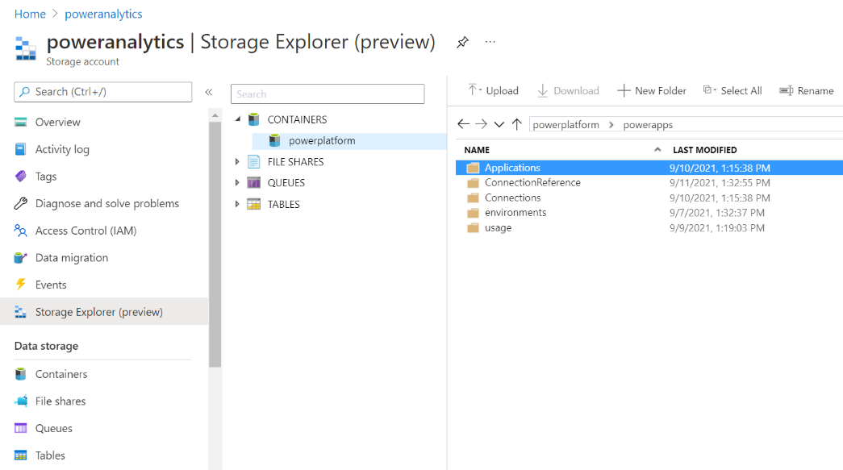
Data Export (preview) Tenant level analytics
Export tenant level analytics to Azure Data Lake
Bring your own lake (BYOL)
Notes:
NOTE!!! Currently data is exported as JSON files but most likely that will be changed in the future to have data available as Common Data Model in Data Lake

Slide 33
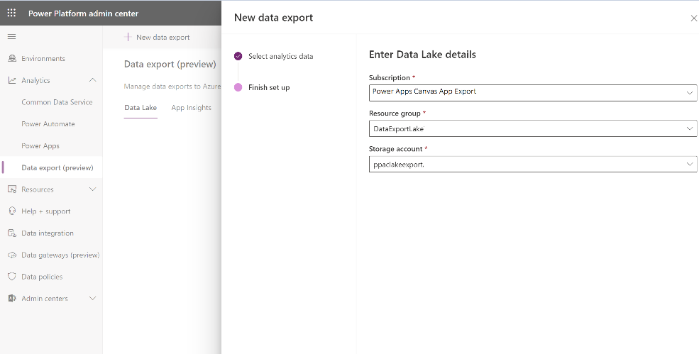
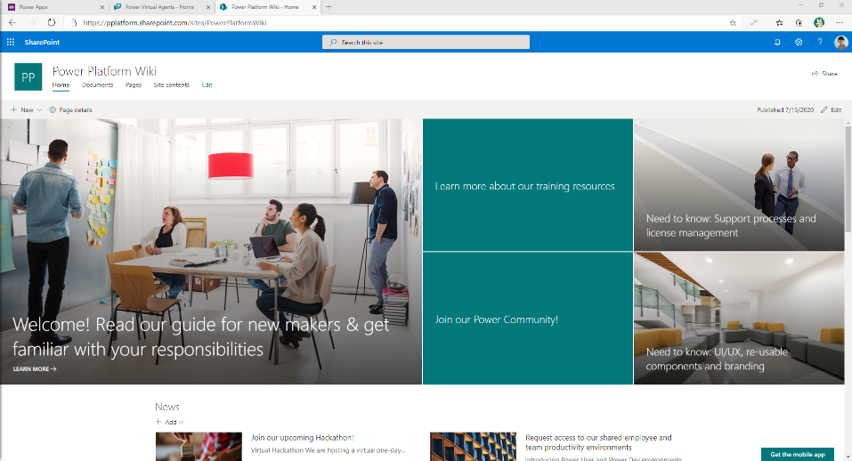
Data Export (preview)
1
Set up Data Lake Export

Slide 34
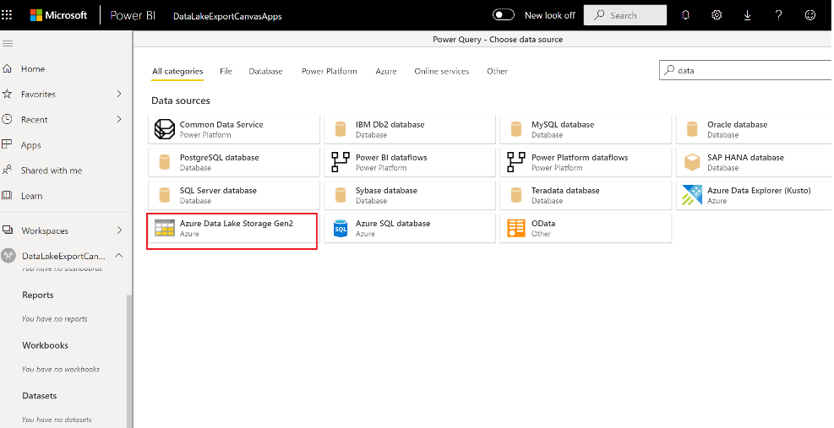
Data Export (preview)
1
Set up Data Lake Export
2
Use Power BI data flows to connect to the data lake

Slide 35
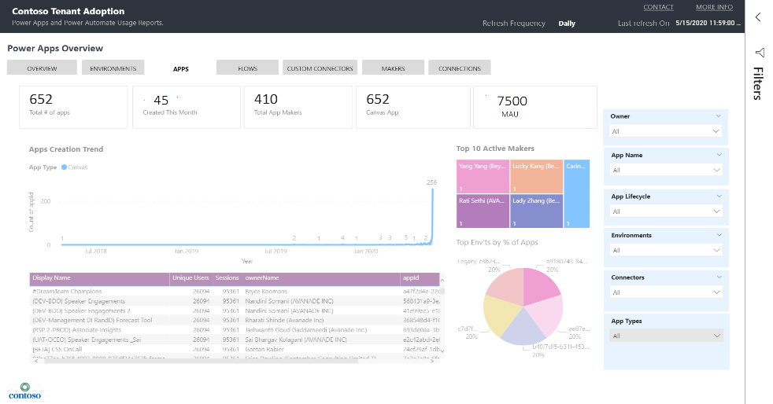
Data Export (preview)
1
Set up Data Lake Export
2
Use Power BI data flows to connect to the data lake
3
Build and share custom reports

Slide 36
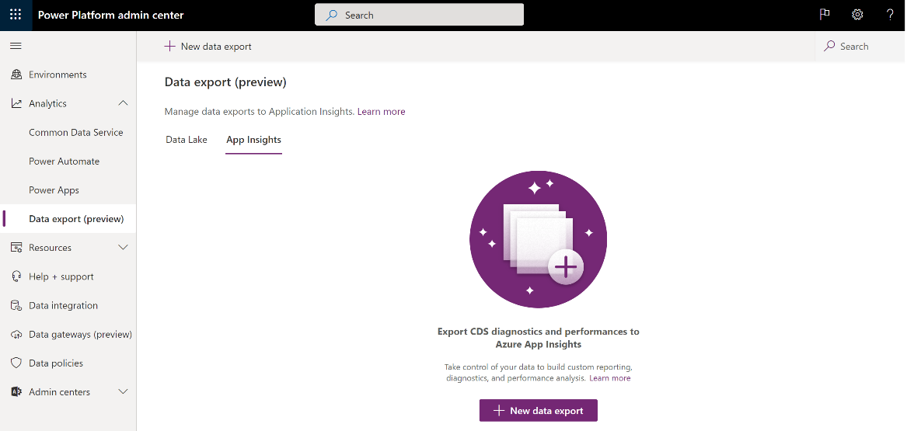
Analyze model-driven apps and Microsoft Dataverse telemetry with Application Insights (preview)

Slide 37
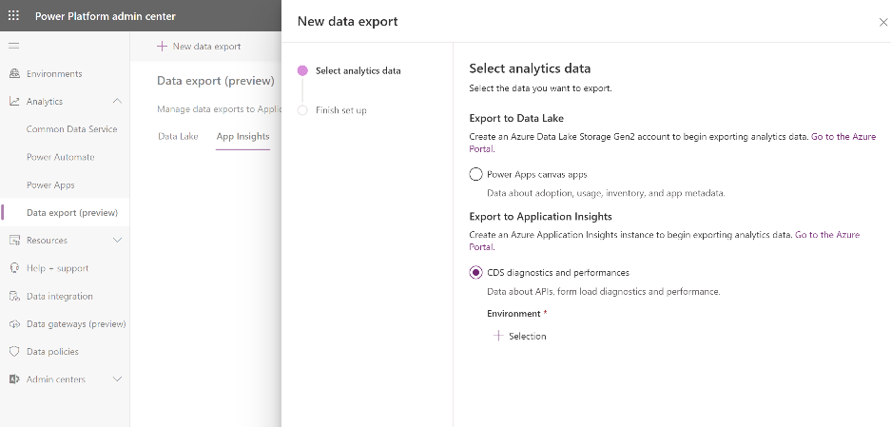
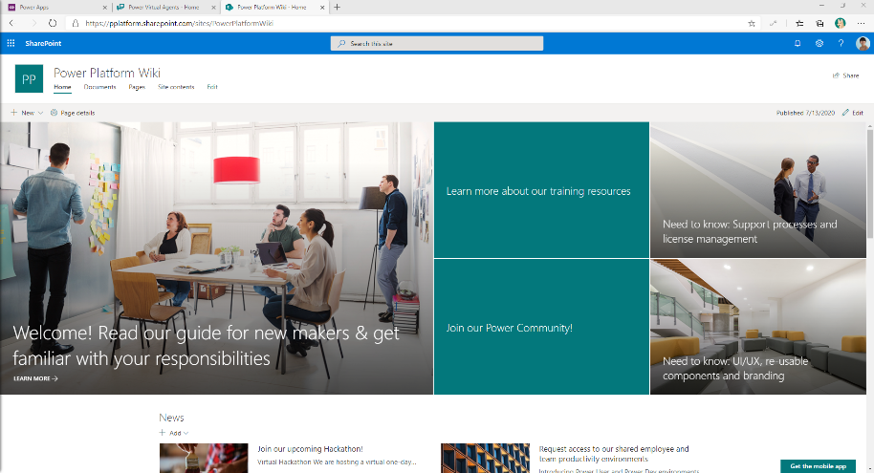
Analyze model-driven apps and Microsoft Dataverse telemetry with Application Insights (preview)
1
Set up continuous export

Slide 38
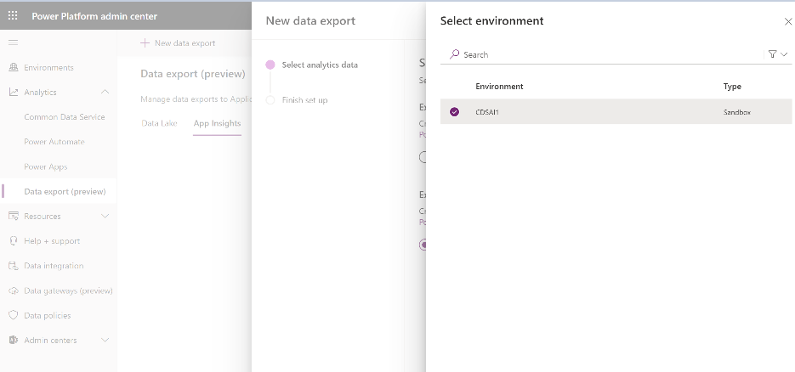
Analyze model-driven apps and Microsoft Dataverse telemetry with Application Insights (preview)
1
Set up continuous export
2
Select environment

Slide 39
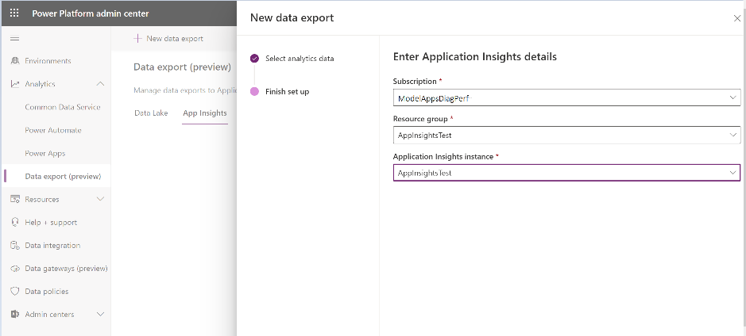
Analyze model-driven apps and Microsoft Dataverse telemetry with Application Insights (preview)
1
Set up continuous export
2
Select environment
3
Provide Application Insights instance

Slide 40
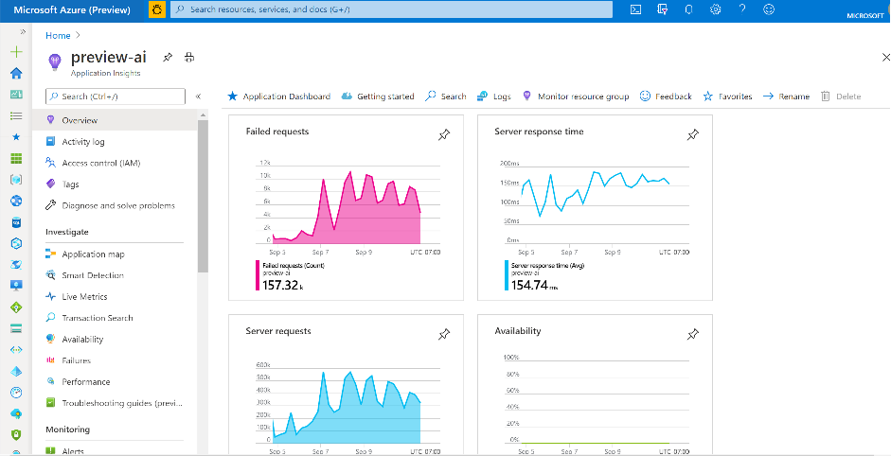
Analyze model-driven apps and Microsoft Dataverse telemetry with Application Insights (preview)
1
Set up continuous export
2
Select environment
3
Provide Application Insights instance
4
OOB reports with App Insights

Slide 41
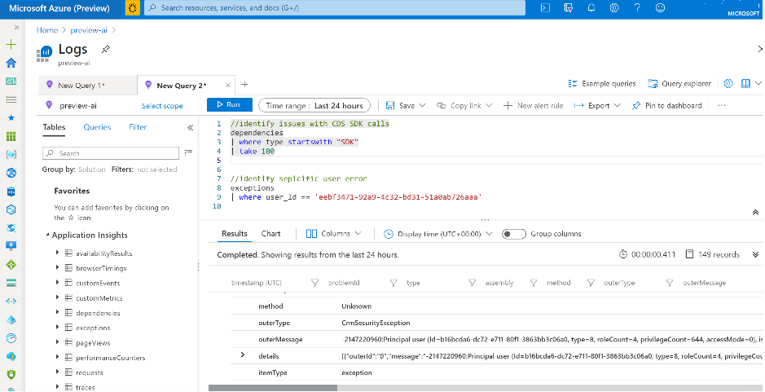
Analyze model-driven apps and Microsoft Dataverse telemetry with Application Insights (preview)
1
Set up continuous export
2
Select environment
3
Provide Application Insights instance
4
OOB reports with App Insights
5
Custom query with Log Analytics

Slide 42
Planned & unplanned platform changes/incidents
4
Notes:
Dataverse is focused on database and model-driven app user activity
PowerApps is targeted toward canvas app
The data is stored only in the region that an environment is hosted in.

Slide 43
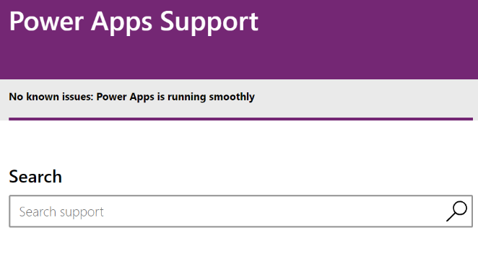
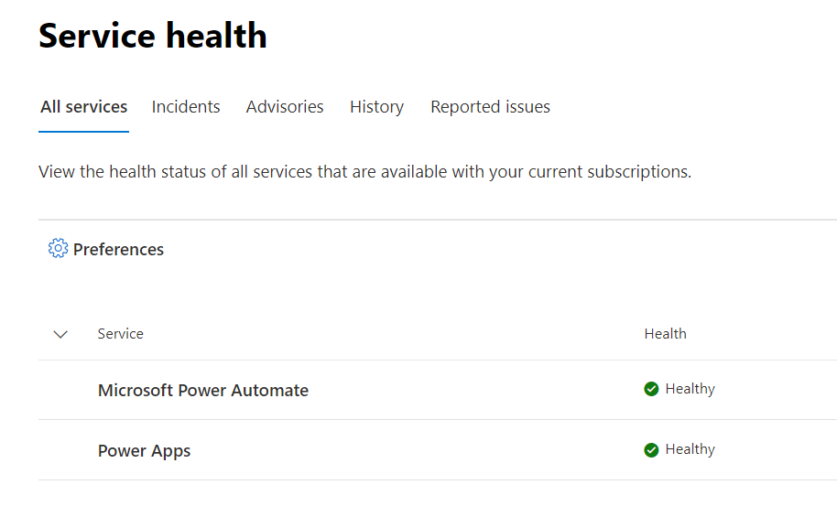
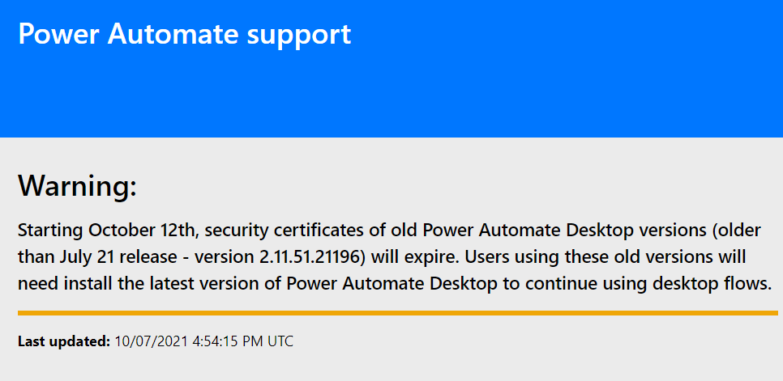
Monitoring platform status
Power Apps and Automate services platform status can been seen in both portals and Office 365 Service Health
https://admin.microsoft.com/Adminportal/Home?source=applauncher#/servicehealth
https://powerapps.microsoft.com/en-us/support
https://flow.microsoft.com/en-us/support
Notes:
Dataverse is focused on database and model-driven app user activity
PowerApps is targeted toward canvas app
The data is stored only in the region that an environment is hosted in.

Slide 44
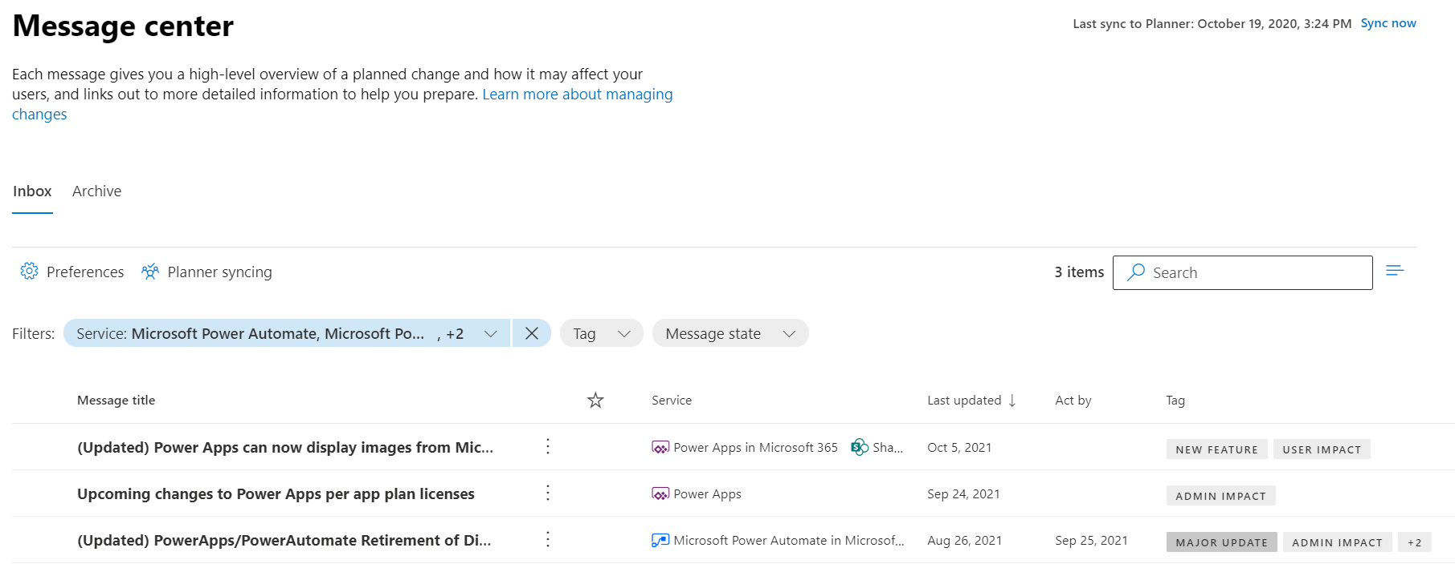
Monitoring platform updates and changes
Power Apps and Automate services platform updates and changes can be monitored in Office 365 Message Center
Notes:
Dataverse is focused on database and model-driven app user activity
PowerApps is targeted toward canvas app
The data is stored only in the region that an environment is hosted in.

